Slide 1
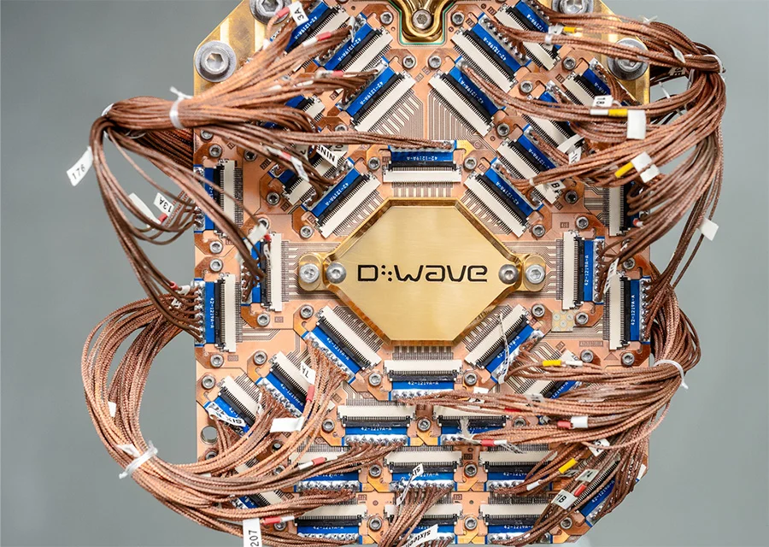
D-Wave Quantum Inc. (QBTS)

Slide 2
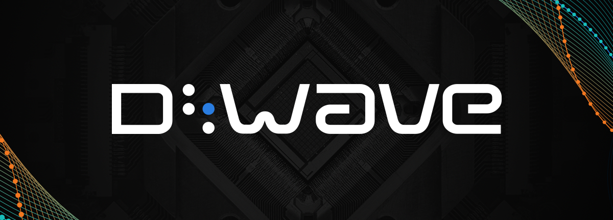

Company Description
Founded in 1999​
Products​
QPU Chips & Computers​
Cloud-Based Optimization Solutions​
Key Partners​
Google​
NASA
Shifting focus from purely annealing to include gate-based​

Slide 3


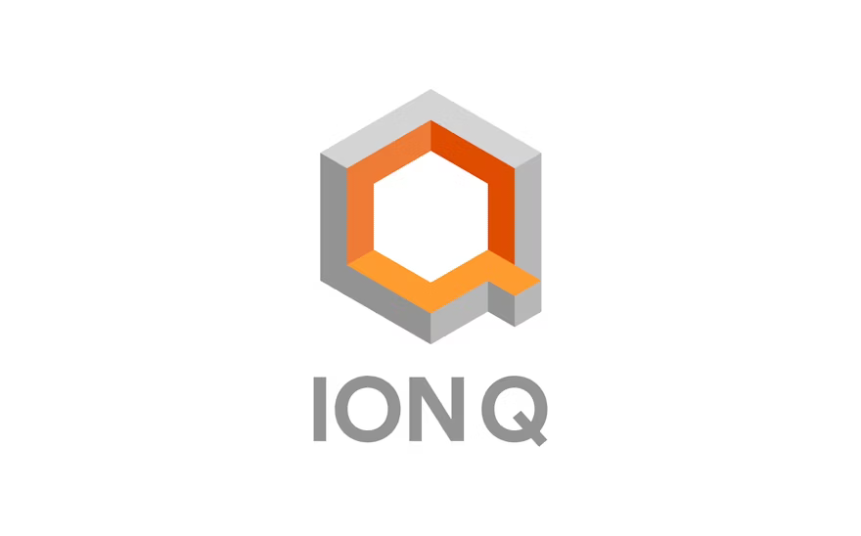

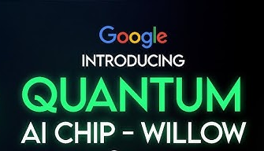
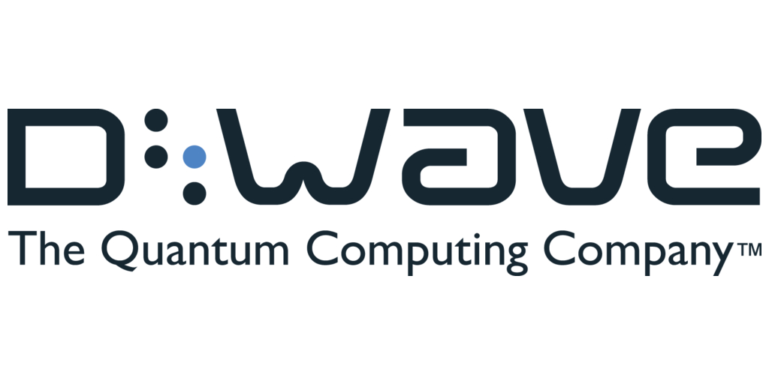


Industry/Peer Comparison​
Company | D-wave Quantum | Rigetti Computing Inc. | IonQ | Quantum Computing. Inc. | IBM Quantum | Google Quantum
Revenue | $8.8M | $10.8M | $43.1M | $373K | $62.8B | N/A
Industries Targeted | Manufacturing, Logistics, Financial Services, Cybersecurity, Healthcare | Government, Aerospace, Financial Modeling, Artificial Intelligence, Healthcare | Finance, Artificial Intelligence, Logistics, Pharmaceuticals, Cybersecurity | Cybersecurity, Optimization, Artificial Intelligence, Biomedicine, Remote Sensing | Financial Services, Healthcare, Energy, Research, Aerospace and Manufacturing | Research, Artificial Intelligence, Materials Science, Pharmaceuticals, Energy
Market Capitalization | $2.208B | $2.264B | $5.272B | $1.16B | $226.25B | $1.878T
Technological Focus | Optimization, Hybrid solvers, Quantum annealing | Superconducting qubits, Hybrid systems, Cloud access | Trapped-ion qubits, High fidelity, Modular architecture | Photonic qubits, Room temperature, Hardware/software | Superconducting qubits, Cloud-based, Error-correcting | Superconducting qubits, Fault tolerance, R&D
Value Proposition | Solves real-world problems with ready to use quantum tools | Combines quantum and classical tech for easy cloud access | High precision quantum you can access online | Simple, low-cost quantum systems for quick use | Makes quantum tech accessible for learning, research, and businesses | Leading research that advances the whole field

Slide 4
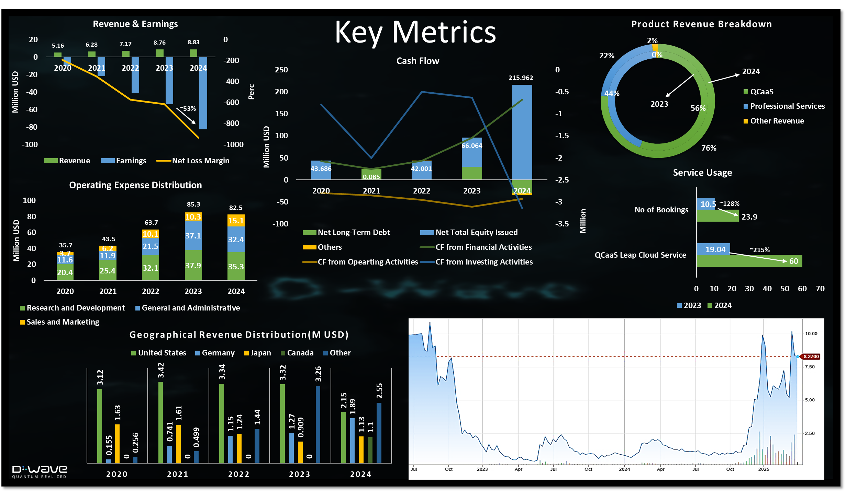

Slide 5
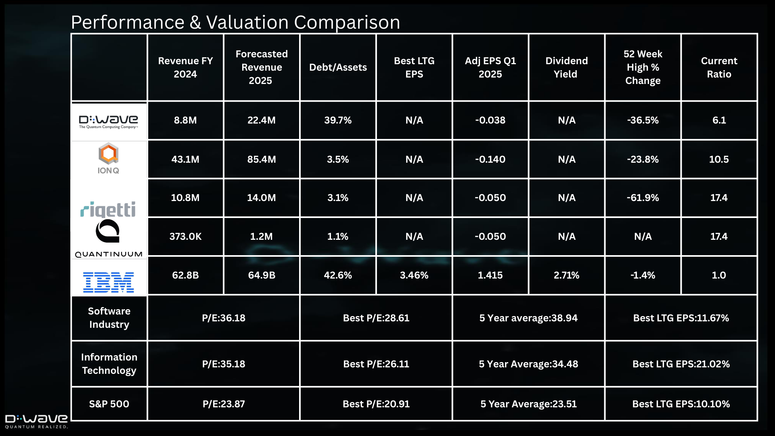
Notes:
D-wave compare to other peers takes on a high leverage compared to other startups; less financially conservative. D-Wave shows early-stage growth potential, but financial stability and investor confidence still lag behind leading players.

Slide 6
Conclusion​
Key Strengths
Specialization in Quantum Annealing
Diverse Customer Base
Strong Research Partnerships
Continuous Innovation
Risk Factors
Financial Strain and Profitability Challenges
Intense Industry Competition
Uncertainty in Development and Advancement
Growth Opportunities
Sector-Specific Applications
Innovation in Quantum Computing Technologies
Expansion of Academic and Research Partnerships

Slide 7
Thank You

